Slide 1
Addressing Customer Churn
For a retail bank
Arun Mitra, Data Scientist

Slide 2

The Problem
What can be done?
For all B2C businesses, including retail banks
Customer lifetime value is key
Loyalty is everything!
Average churn for retail banks is 20% to 25% (Source:https://www.qualtrics.com/blog/customer-churn-banking/)
Lost revenue from churned ex-customers is very hard to replace
Identify likely churners
Launch targeted retention campaigns
Get frequent feedback
Improve customer service
Improve digital self-service
Reduce fees & rates
Increase savings interest rates
Offer a wider variety of financial products
All of the above cost a varying amount of $$$$. How much should we spend?
We need a Profit Curve!

Slide 3
The Goal of this Project
The process
Implement an optimal supervised machine learning model (or a pipeline of an ensemble of models) to best predict customer churn
Derive a Profit Curve to understand the kind of budget that would be justifiable to craft a retention program
Data: Get enough labelled data
EDA: Explore and analyze the data
Score: Set a metric to evaluate the models
Base model: Iterate through various model options to find the best base model
Tune Model: Gridsearch for the best hyperparameters
Profit Curve: Plug in cost-benefit numbers to find optimal campaign budgets

Slide 4
The Data
The process
Data Source
Neuraldesigner (https://www.neuraldesigner.com/learning/examples/bank-churn#DataSet)
Description of Data:
Anonymized European Retail Bank customer data with ~10,000 rows and 12 features
customer_id
credit_score
country
gender
age
tenure
balance
products_number
credit_card
active_member
estimated_salary
And a churn (or not) label
Data: Get enough labelled data
EDA: Explore and analyze the data
Score: Set a metric to evaluate the models
Base model: Iterate through various model options to find the best base model
Tune Model: Gridsearch for the best hyperparameters
Profit Curve: Plug in cost-benefit numbers to find optimal campaign budgets

Slide 5
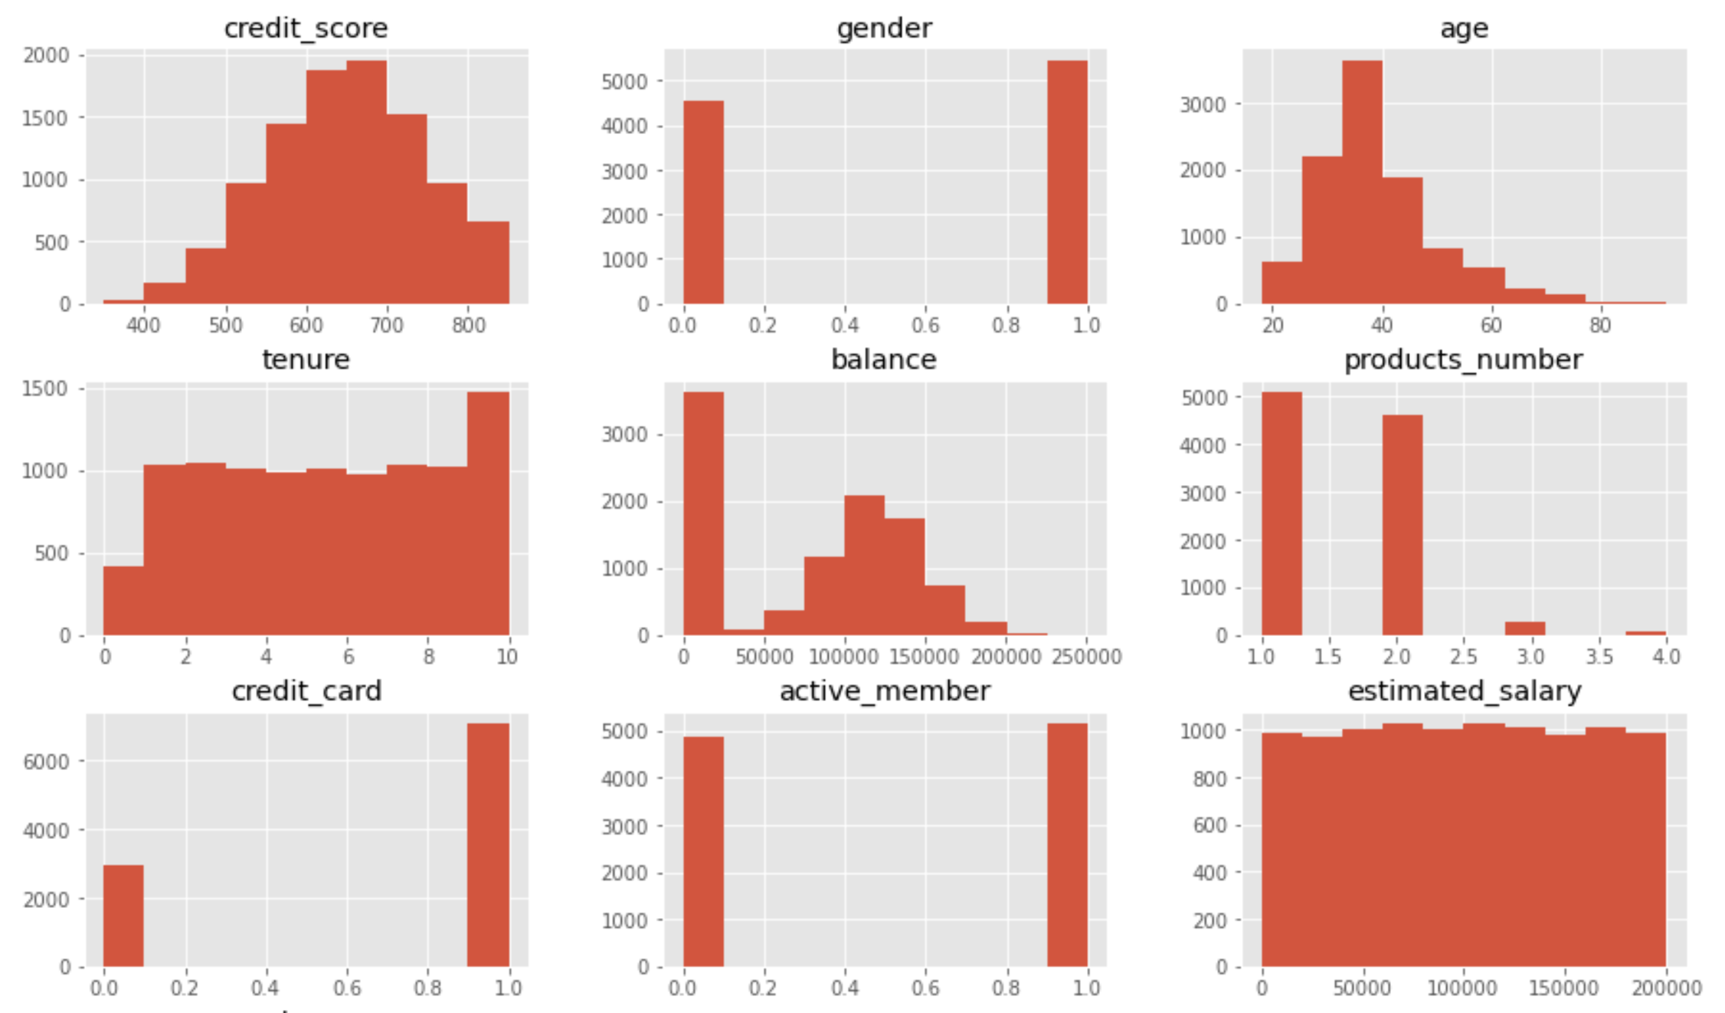
EDA
The process
Overall churn percentage : 20.37%
A balanced, well-crafted sample
Data: Get enough labelled data
EDA: Explore and analyze the data
Score: Set a metric to evaluate the models
Base model: Iterate through various model options to find the best base model
Tune Model: Gridsearch for the best hyperparameters
Profit Curve: Plug in cost-benefit numbers to find optimal campaign budgets

Slide 6
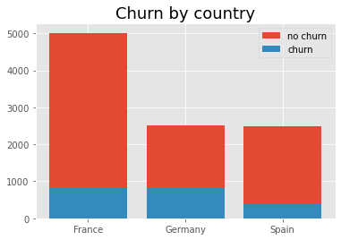
EDA
The process
Explored some intuitive questions:
Data: Get enough labelled data
EDA: Explore and analyze the data
Score: Set a metric to evaluate the models
Base model: Iterate through various model options to find the best base model
Tune Model: Gridsearch for the best hyperparameters
Profit Curve: Plug in cost-benefit numbers to find optimal campaign budgets

Slide 7
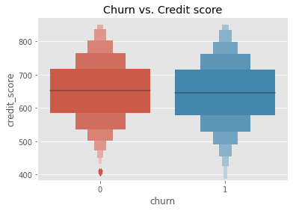
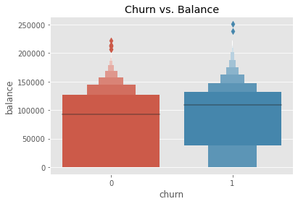
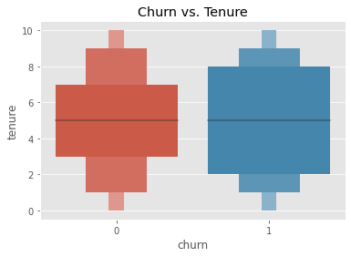
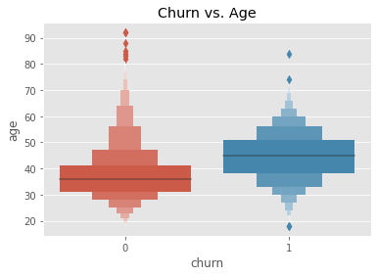
EDA
The process
Explored some intuitive questions:
Data: Get enough labelled data
EDA: Explore and analyze the data
Score: Set a metric to evaluate the models
Base model: Iterate through various model options to find the best base model
Tune Model: Gridsearch for the best hyperparameters
Profit Curve: Plug in cost-benefit numbers to find optimal campaign budgets

Slide 8
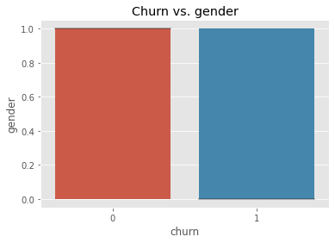
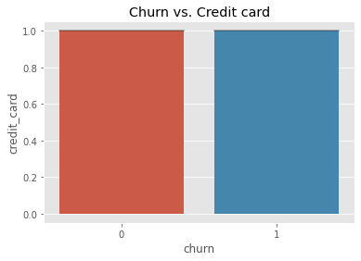
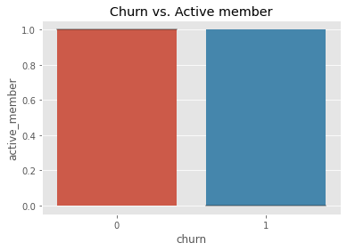
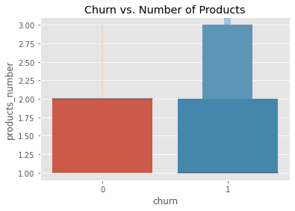
EDA
The process
Explored some intuitive questions:
Data: Get enough labelled data
EDA: Explore and analyze the data
Score: Set a metric to evaluate the models
Base model: Iterate through various model options to find the best base model
Tune Model: Gridsearch for the best hyperparameters
Profit Curve: Plug in cost-benefit numbers to find optimal campaign budgets

Slide 9
Decide on model metric
The process
Recall: is the metric we are most interested in because false negatives (not finding churners) is what we most want to minimize.
Precision: is also interesting
Accuracy: should not be too low
Data: Get enough labelled data
EDA: Explore and analyze the data
Score: Set a metric to evaluate the models
Base model: Iterate through various model options to find the best base model
Tune Model: Gridsearch for the best hyperparameters
Profit Curve: Plug in cost-benefit numbers to find optimal campaign budgets

Slide 10
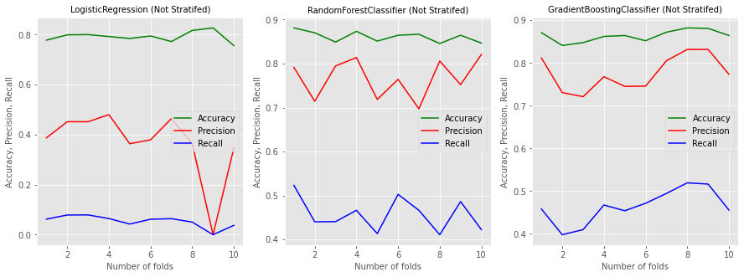
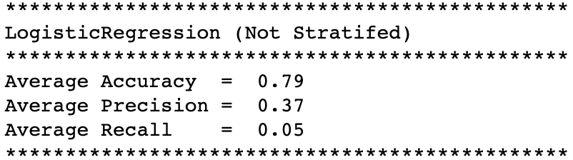
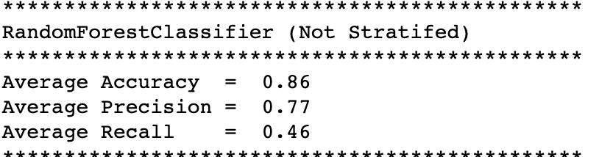
Find the Base Model
The process
Started working with 3 options:
Logistic Regression
Random Forest Classifier
Gradient Boosting Classifier
First results:
Data: Get enough labelled data
EDA: Explore and analyze the data
Score: Set a metric to evaluate the models
Base model: Iterate through various model options to find the best base model
Tune Model: Gridsearch for the best hyperparameters
Profit Curve: Plug in cost-benefit numbers to find optimal campaign budgets

Slide 11
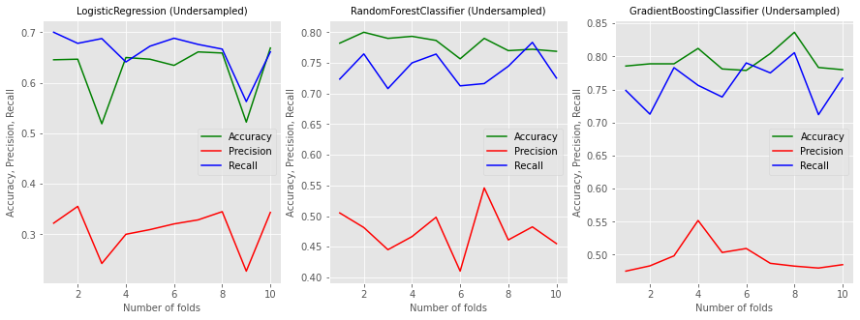
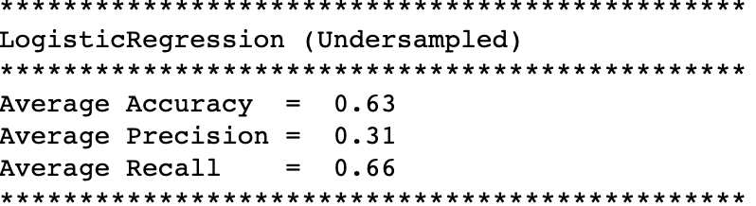
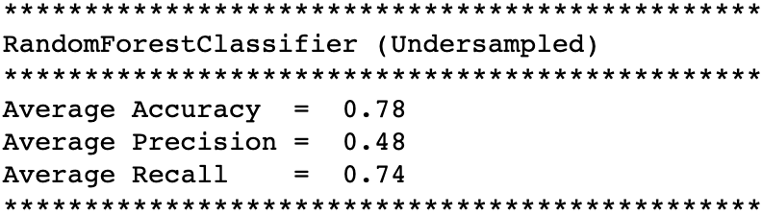
Find the Base Model
The process
Poor Recall: Caused by class imbalance
Undersampled the majority class:
Data: Get enough labelled data
EDA: Explore and analyze the data
Score: Set a metric to evaluate the models
Base model: Iterate through various model options to find the best base model
Tune Model: Gridsearch for the best hyperparameters
Profit Curve: Plug in cost-benefit numbers to find optimal campaign budgets

Slide 12
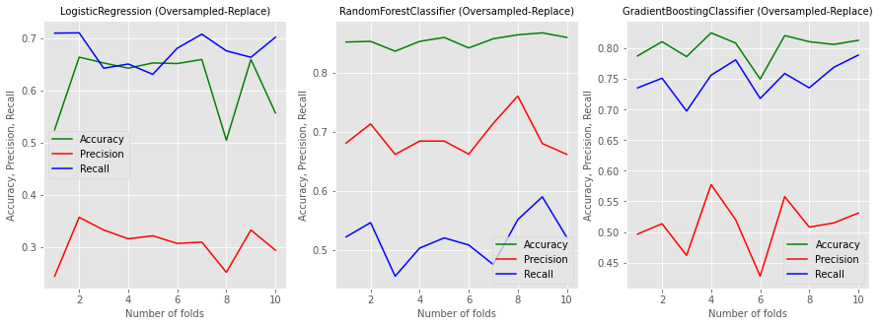
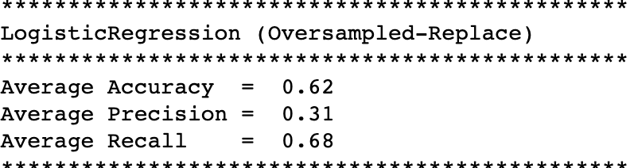
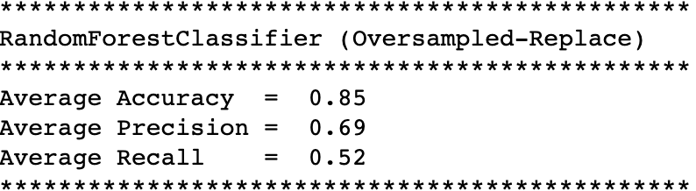
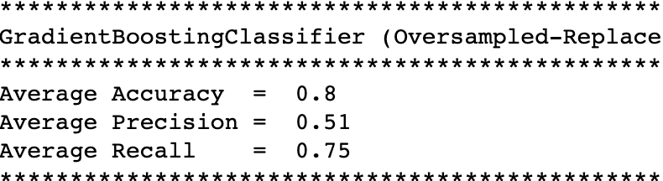
Find the Base Model
The process
Poor Recall: Caused by class imbalance
Oversampled the minority class:
Data: Get enough labelled data
EDA: Explore and analyze the data
Score: Set a metric to evaluate the models
Base model: Iterate through various model options to find the best base model
Tune Model: Gridsearch for the best hyperparameters
Profit Curve: Plug in cost-benefit numbers to find optimal campaign budgets

Slide 13
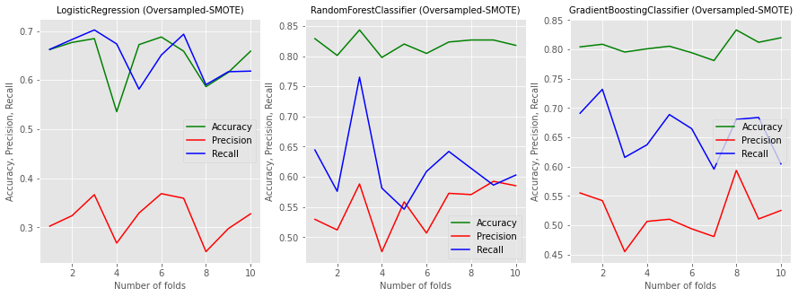
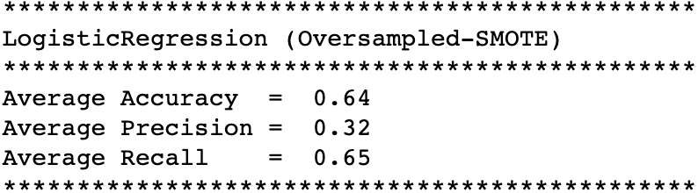
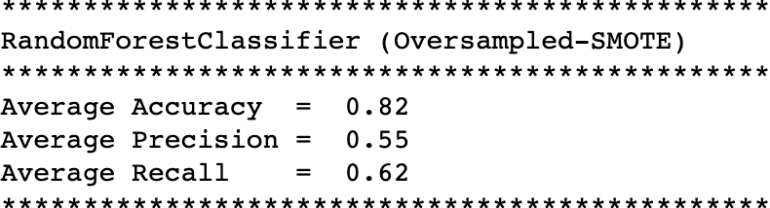
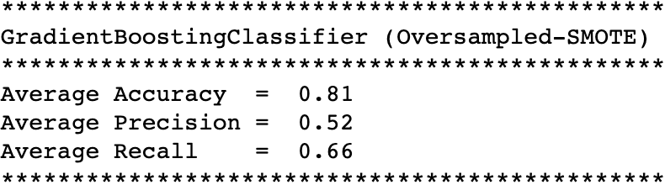
Find the Base Model
The process
Poor Recall: Caused by class imbalance
SMOTE oversampling the minority:
Data: Get enough labelled data
EDA: Explore and analyze the data
Score: Set a metric to evaluate the models
Base model: Iterate through various model options to find the best base model
Tune Model: Gridsearch for the best hyperparameters
Profit Curve: Plug in cost-benefit numbers to find optimal campaign budgets

Slide 14
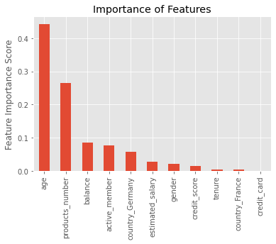
Find the Base Model
The process
Selected GradientBoostingClassifier
********************************************
Model: GradientBoostingClassifier
********************************************
Accuracy = 0.82
Precision = 0.55
Recall = 0.748
********************************************
With random-oversampling of the minority class during model training
Data: Get enough labelled data
EDA: Explore and analyze the data
Score: Set a metric to evaluate the models
Base model: Iterate through various model options to find the best base model
Tune Model: Gridsearch for the best hyperparameters
Profit Curve: Plug in cost-benefit numbers to find optimal campaign budgets
Explored dropping the least important features but this did not improve the model

Slide 15
Tune the Base Model
The process
Gridsearched (for several hours) on a number of options for hyperparameters - then got this
Comparing model with gridsearch params to initial model on Test set.
Results for GradientBoostingClassifier
Gridsearched model Recall: 0.709
Default model Recall: 0.748
Base Model is better.
Staying with the Base Model.
Data: Get enough labelled data
EDA: Explore and analyze the data
Score: Set a metric to evaluate the models
Base model: Iterate through various model options to find the best base model
Tune Model: Gridsearch for the best hyperparameters
Profit Curve: Plug in cost-benefit numbers to find optimal campaign budgets

Slide 16
Profit Curve
The process
Assumptions:
A customer who leaves the bank will result in average annual revenue loss of $1000
~Retail Lending Interest Rate: 1.80%
~Retail Deposit Interest Rate: 0.37% (Source: European Central Bank 2019)
~Average balance/customer (in sample): $76,485
~Average earning/customer (in sample):
$76,486 * (0.18 - 0.037) = $1,094
~Cross-validated with Annual Report of JP Morgan Chase from 2011 which had = $912 (Source: http://investor.shareholder.com/jpmorganchase/annual.cfm)
$200 per likely-to-churn-customer, which could pay for:
Rate reductions
Or a birthday credit from the bank
Or individual outreach by customer service
Or a glossy brochure
Etc.
Retention Program is 100% effective
Data: Get enough labelled data
EDA: Explore and analyze the data
Score: Set a metric to evaluate the models
Base model: Iterate through various model options to find the best base model
Tune Model: Gridsearch for the best hyperparameters
Profit Curve: Plug in cost-benefit numbers to find optimal campaign budgets

Slide 17
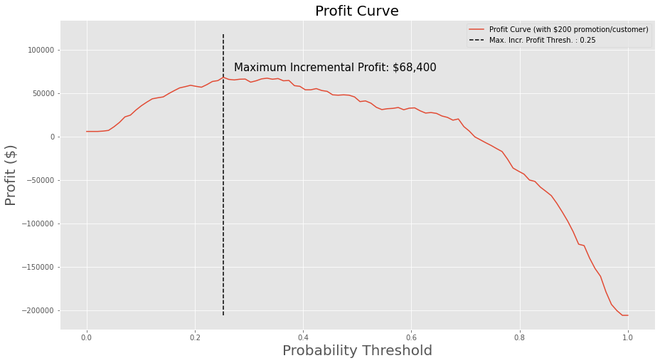
Profit Curve
The process
Conclusions:
A conservative churn probability threshold of ~0.25
Maximizes profit at ~$68.5K with a $200 / customer retention program
Data: Get enough labelled data
EDA: Explore and analyze the data
Score: Set a metric to evaluate the models
Base model: Iterate through various model options to find the best base model
Tune Model: Gridsearch for the best hyperparameters
Profit Curve: Plug in cost-benefit numbers to find optimal campaign budgets

Slide 18
Next Steps
Try Neural Network models
All customers are not the same
High-Value vs Low-Value
Identify the persuadables
Explore Uplift models
Explore Profit Curve for various retention costs
Thank you for your attention!

